Slide 1
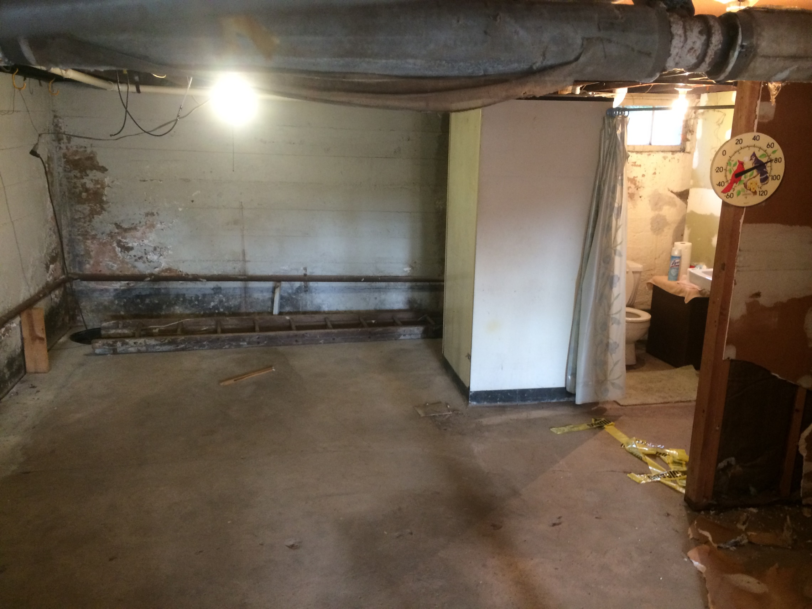
Determine where to put the wall.

Slide 2
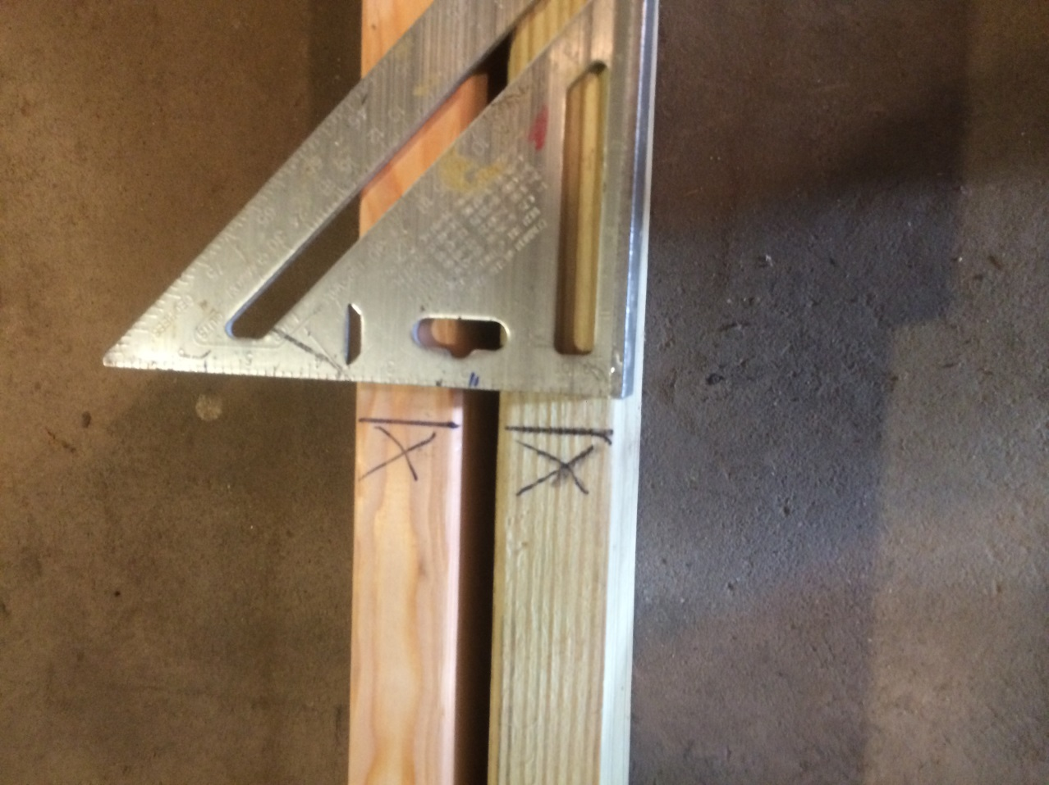
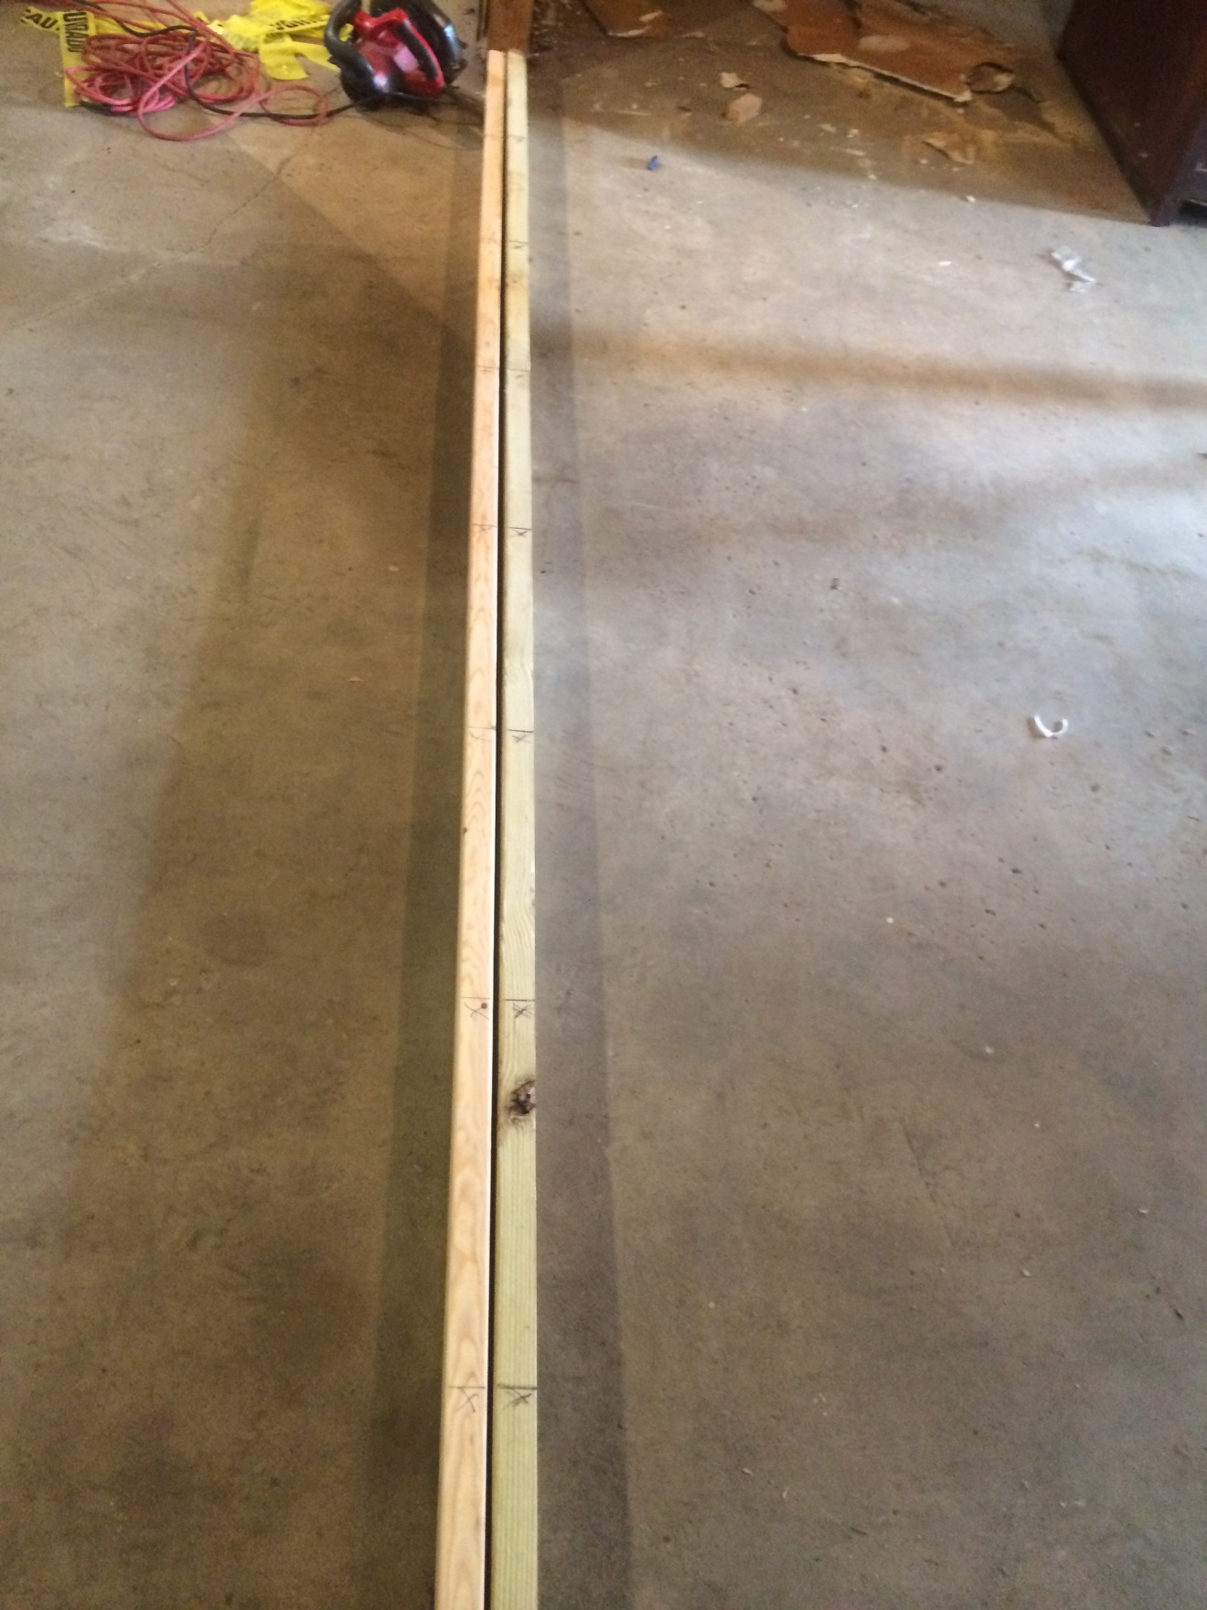
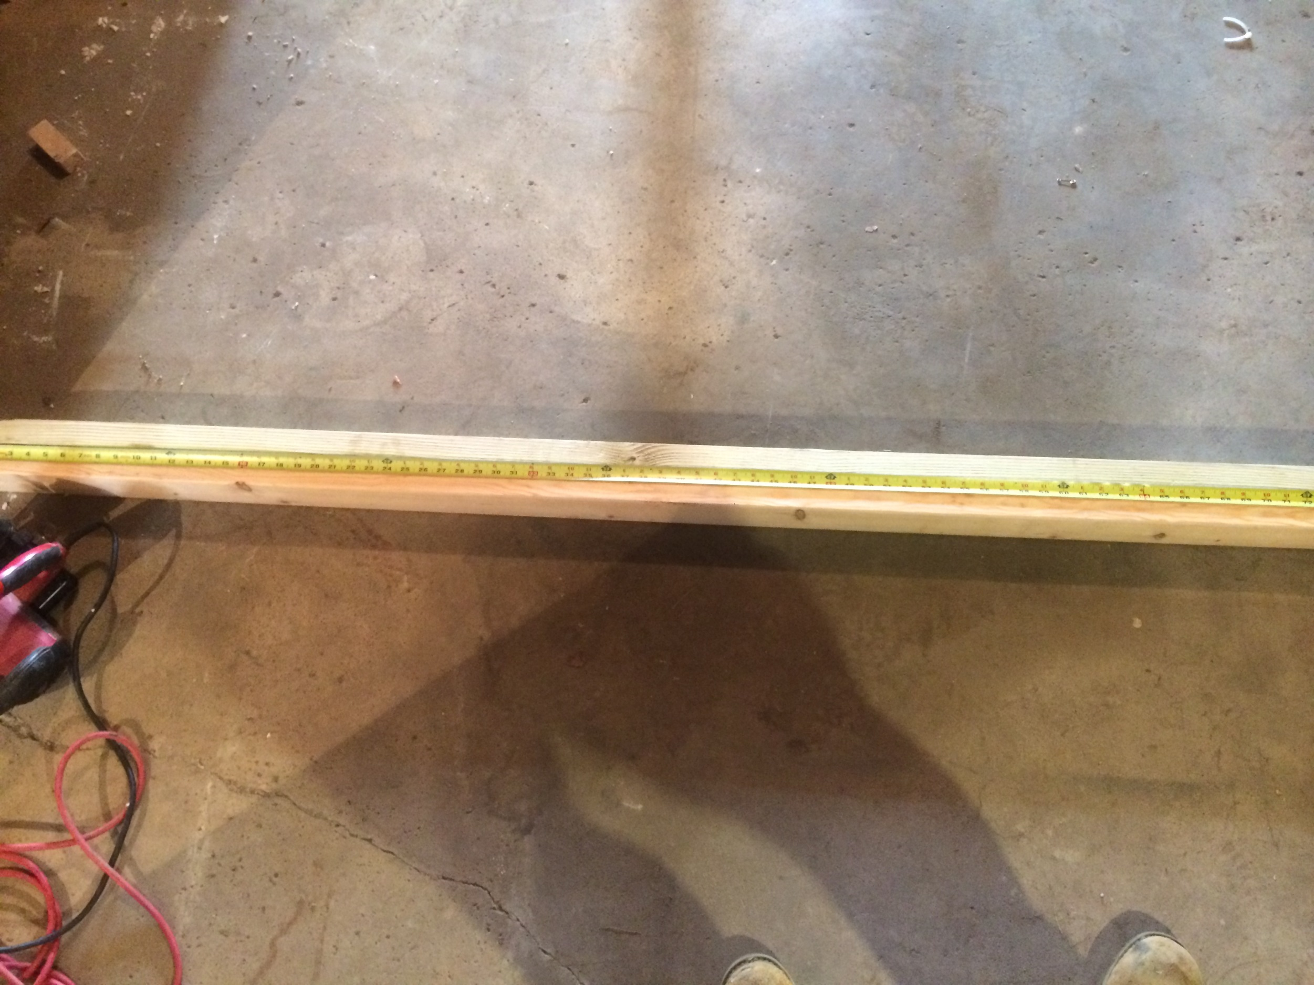
Determine length of sole and top plates. Layout stud position on both at the same time.

Slide 3
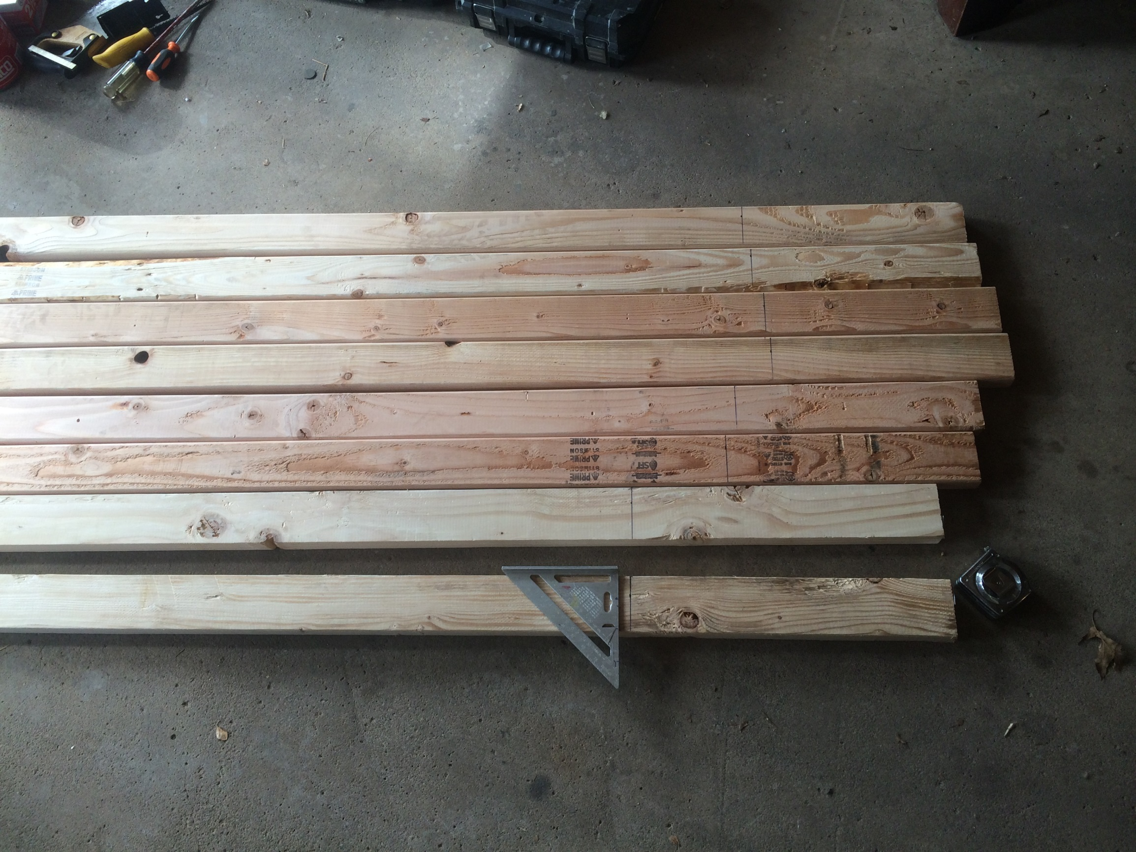
Measure and mark length of studs

Slide 4
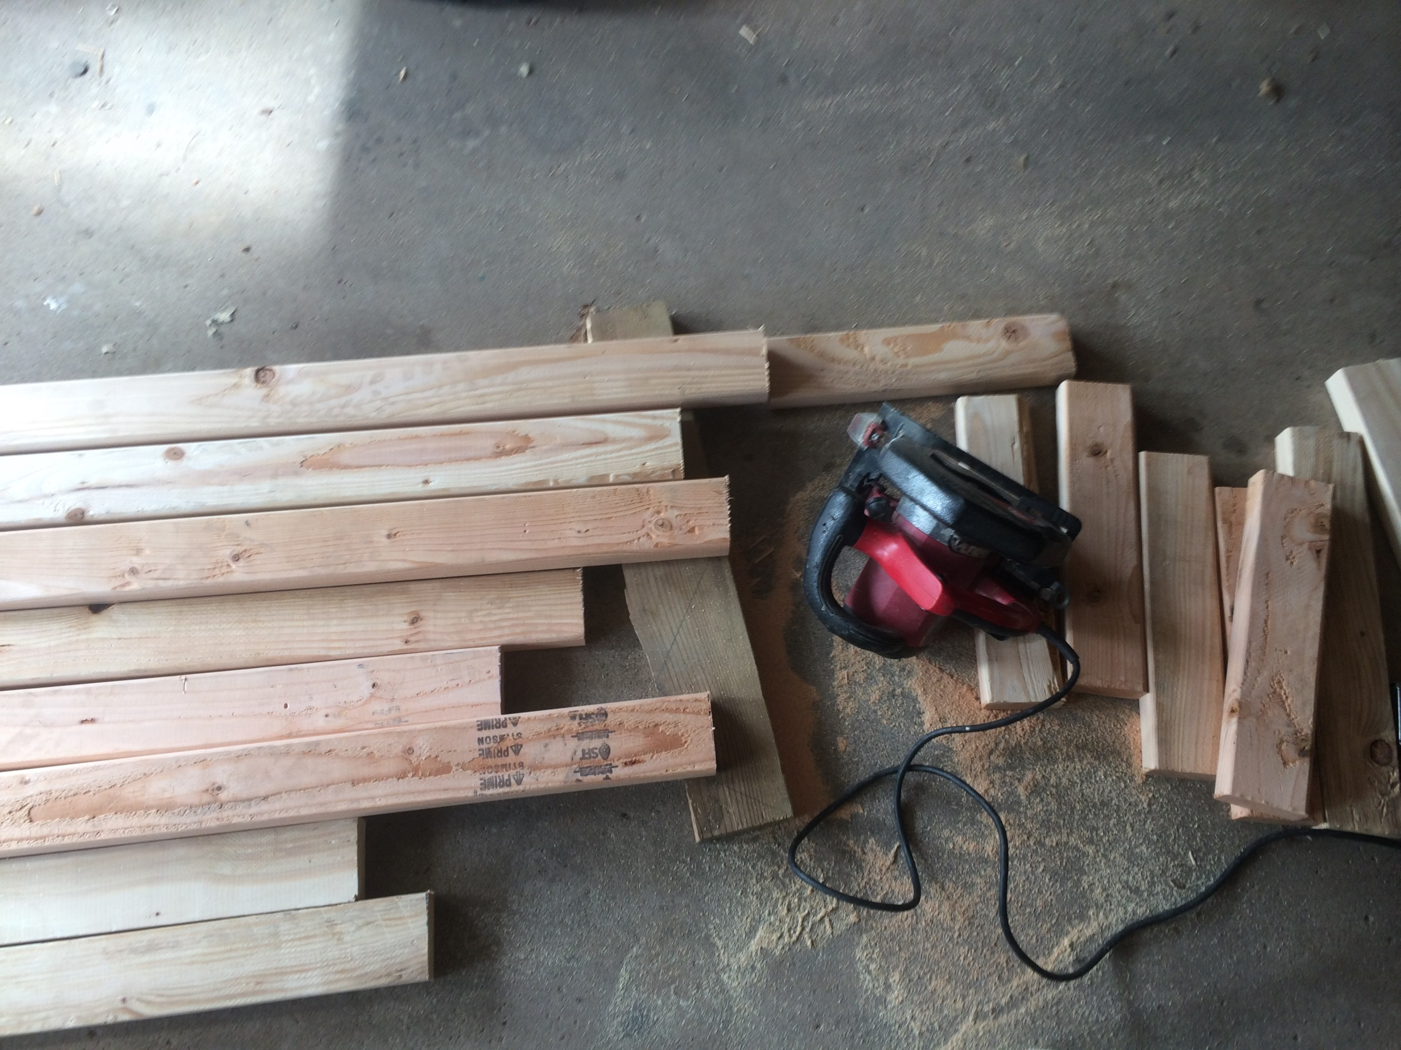
Cut studs to length

Slide 5
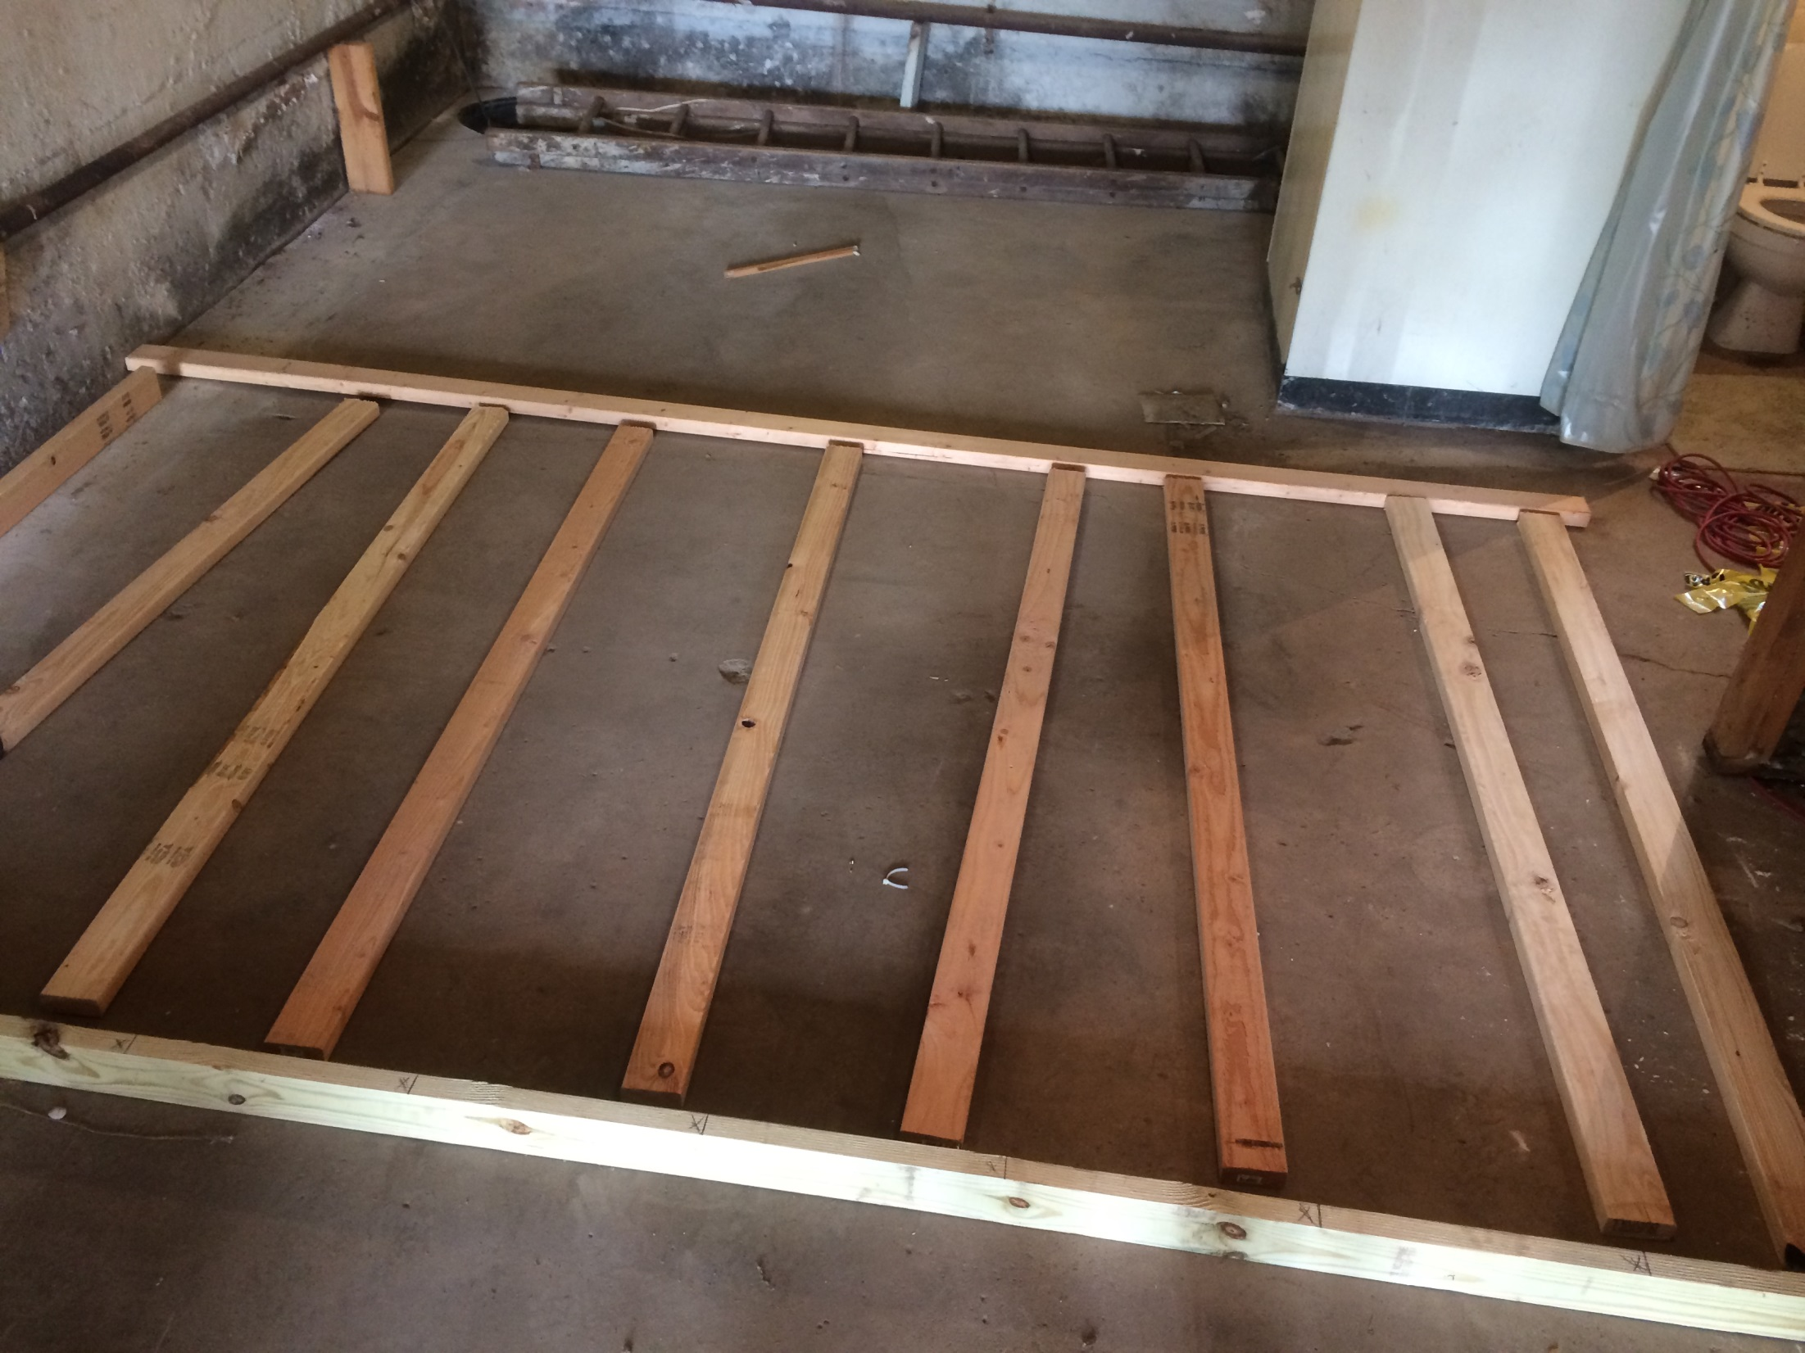
Lay studs out between top and sole plates

Slide 6
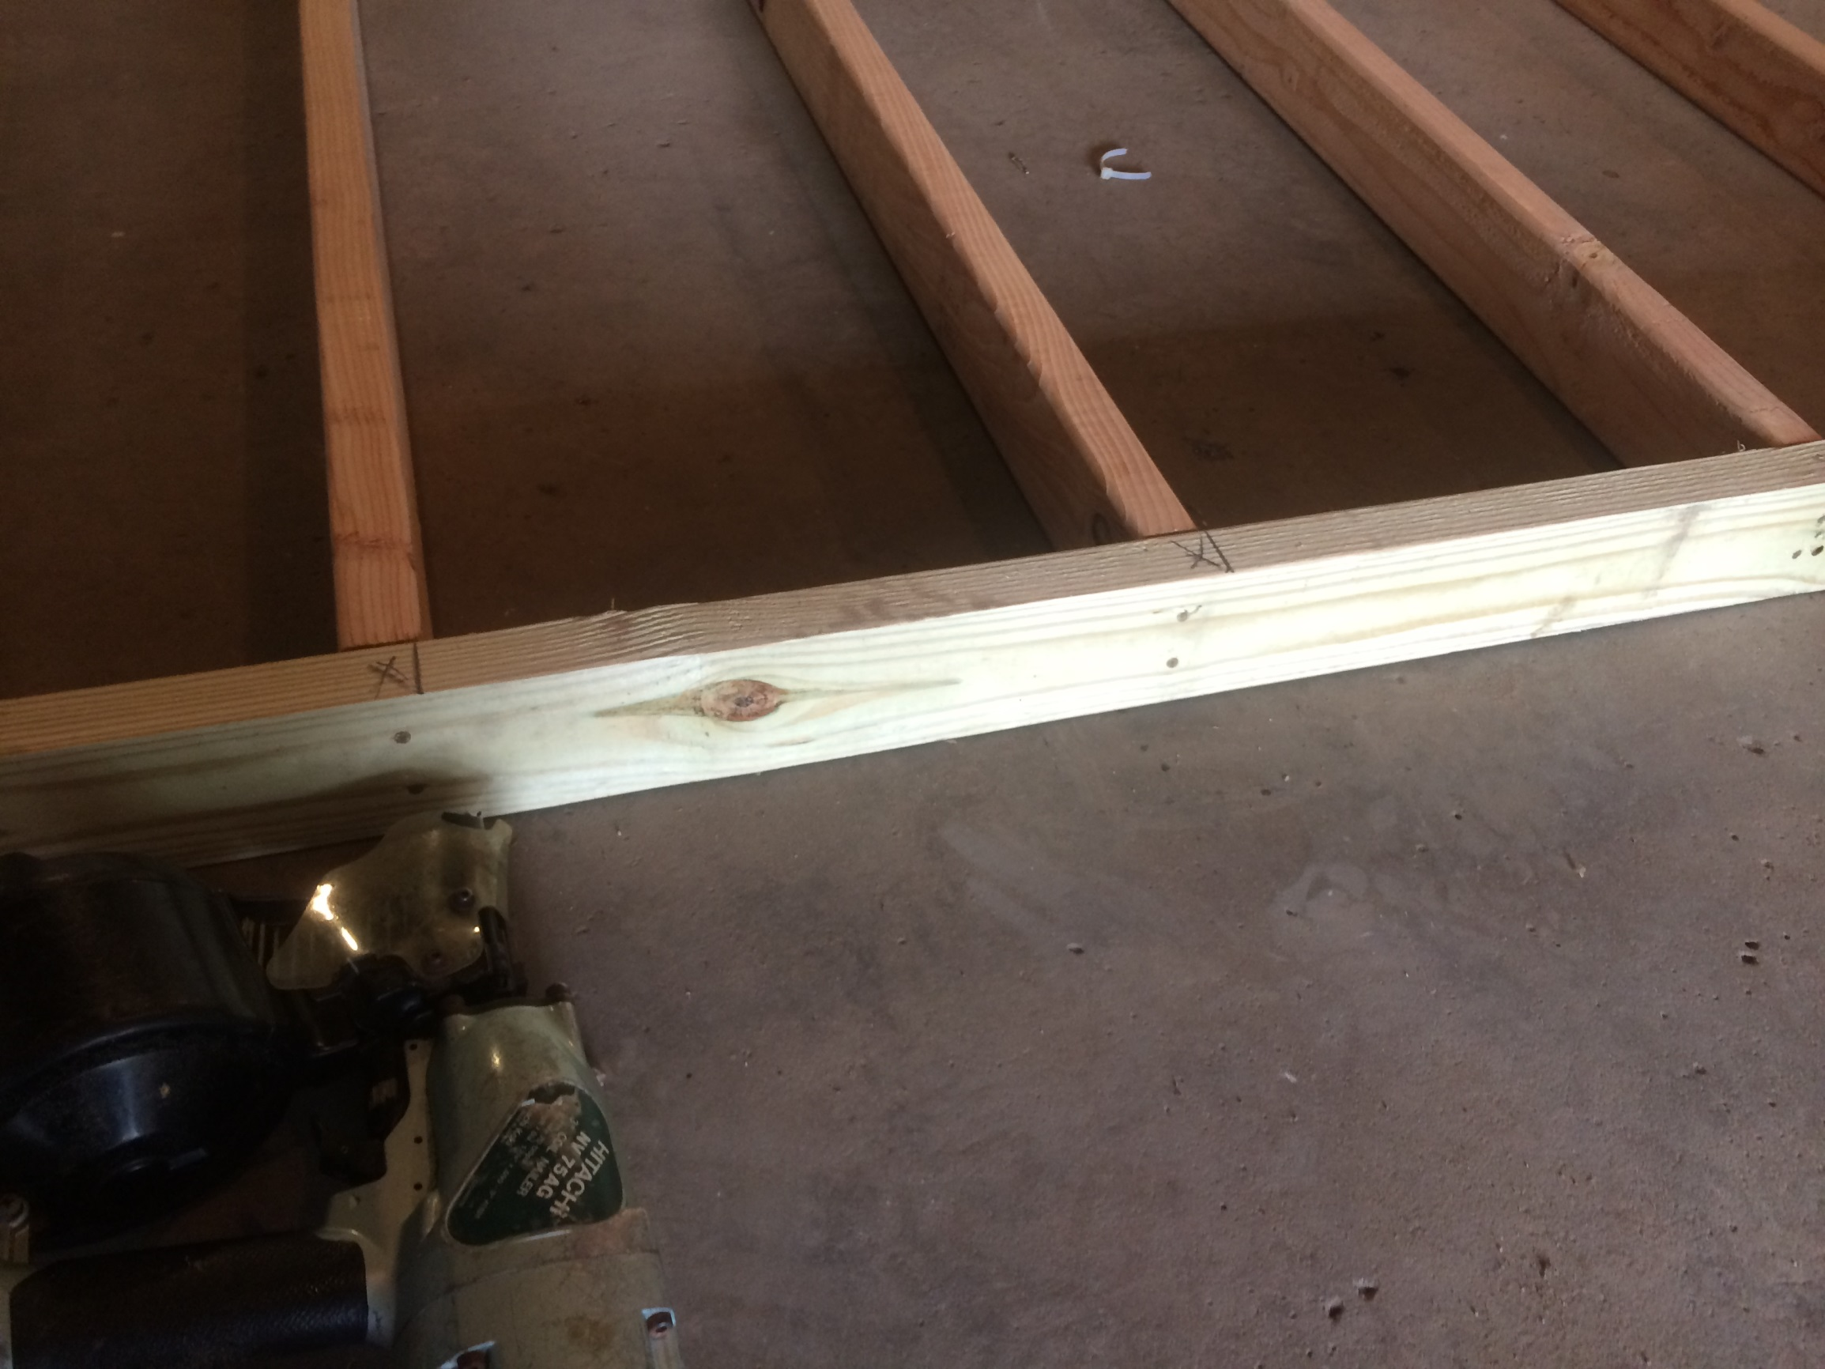
Nail through plates into studs to attach them.

Slide 7
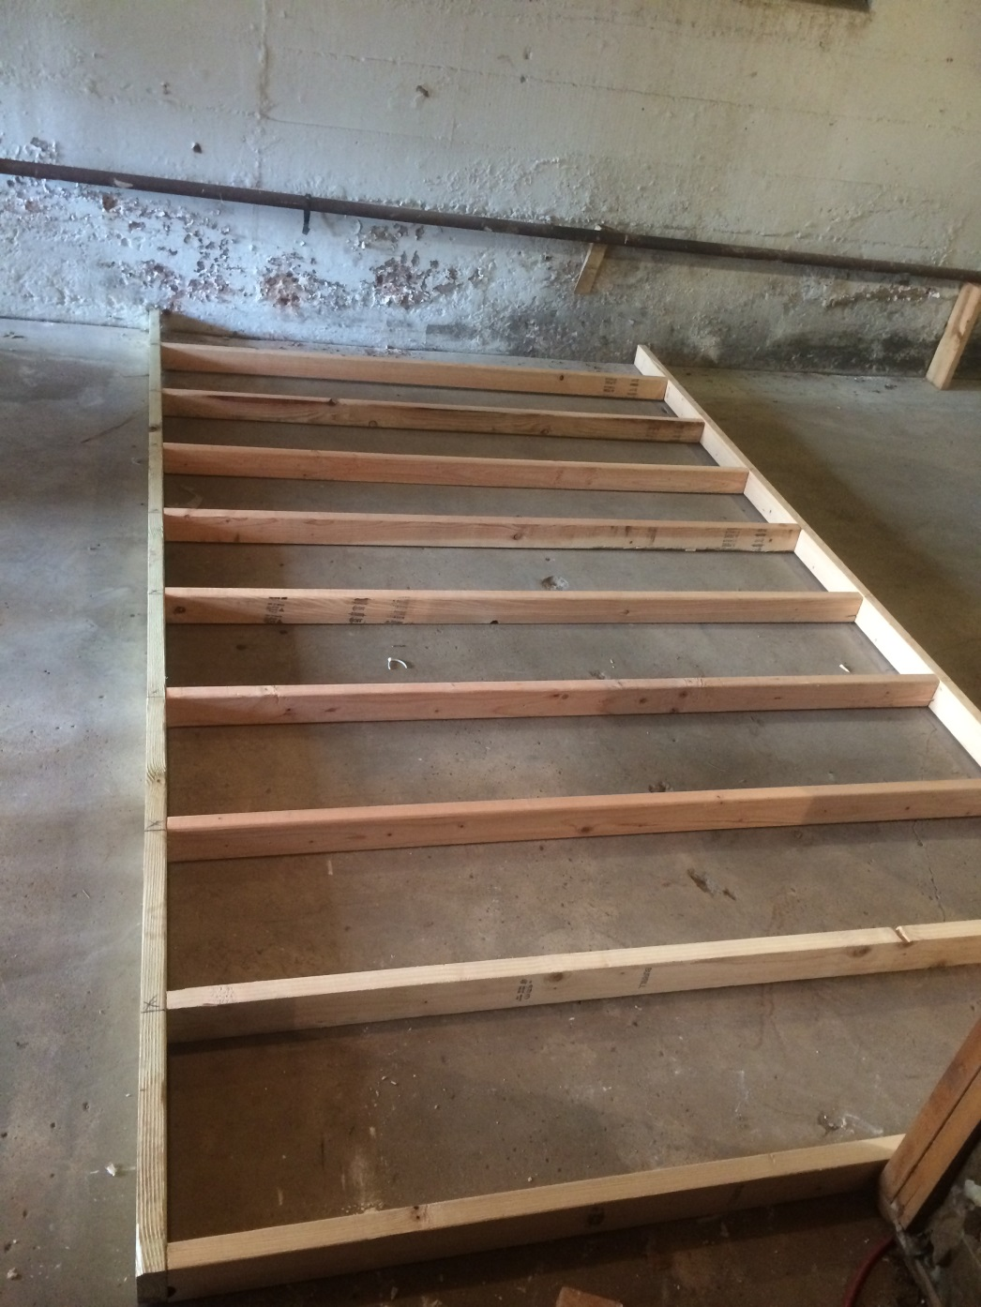
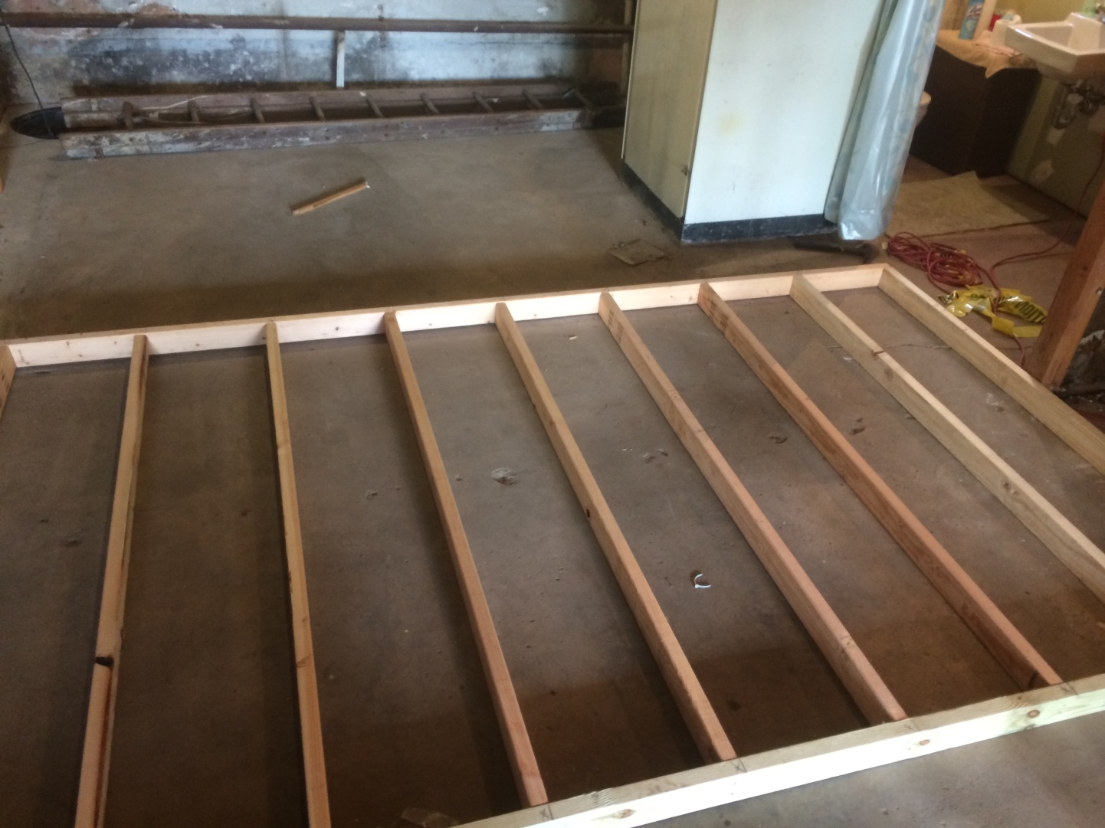
Completed wall section with all studs secured

Slide 8
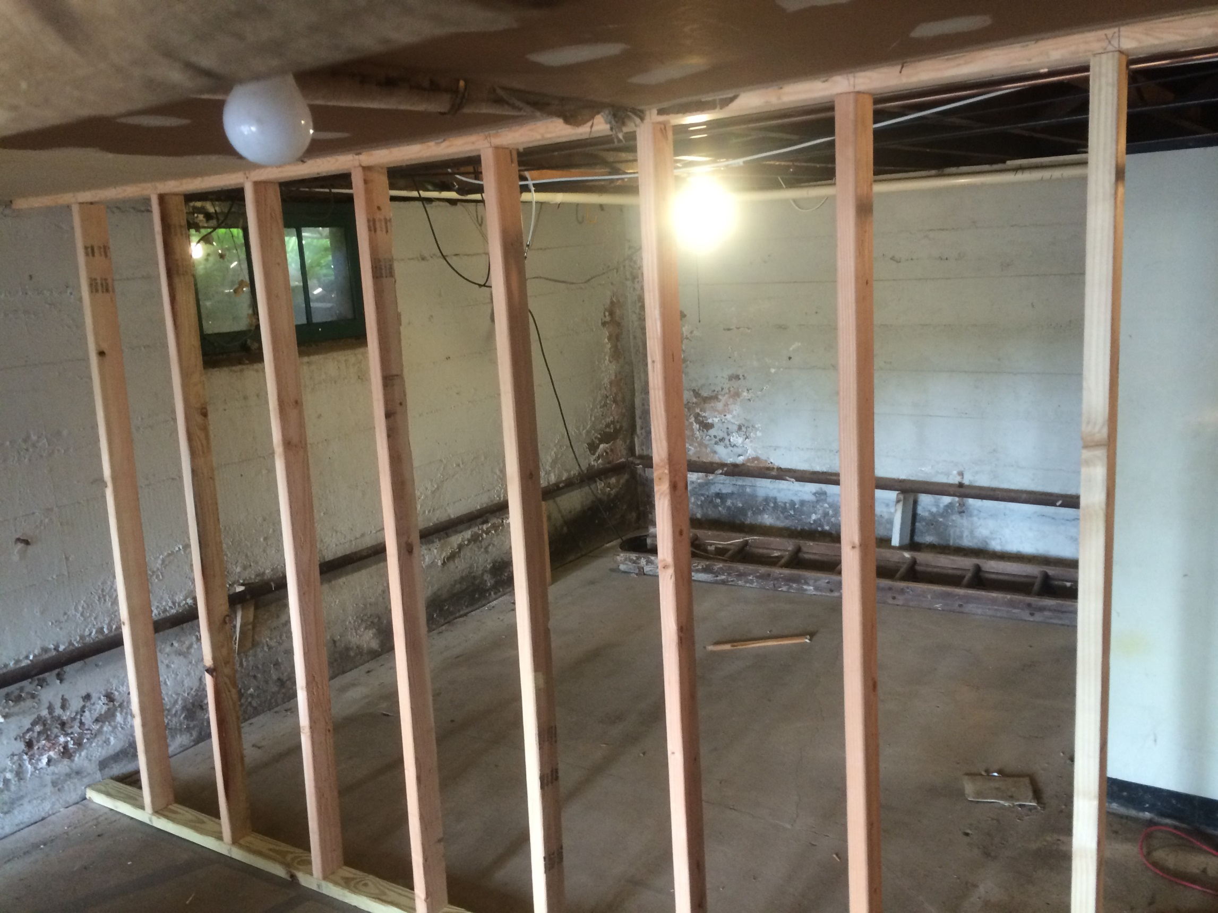
Raise wall into place

Slide 9
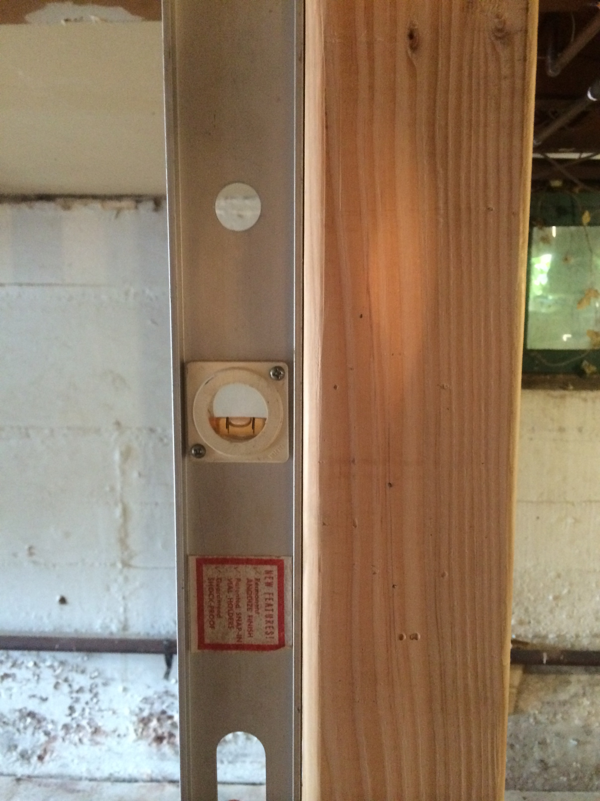
Check for plumb

Slide 10
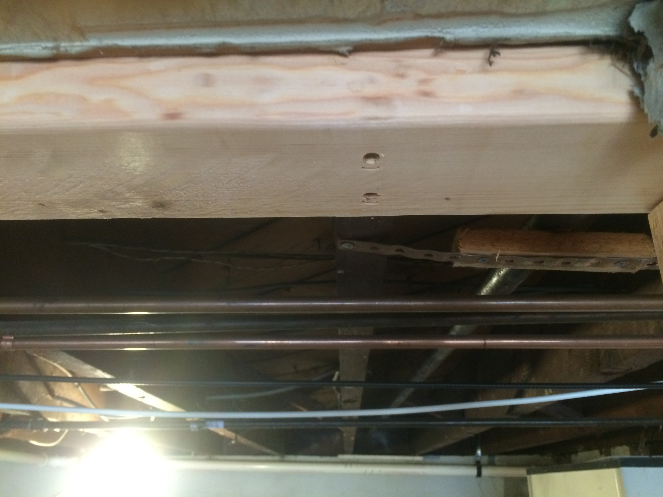
Secure to ceiling joists

Slide 11
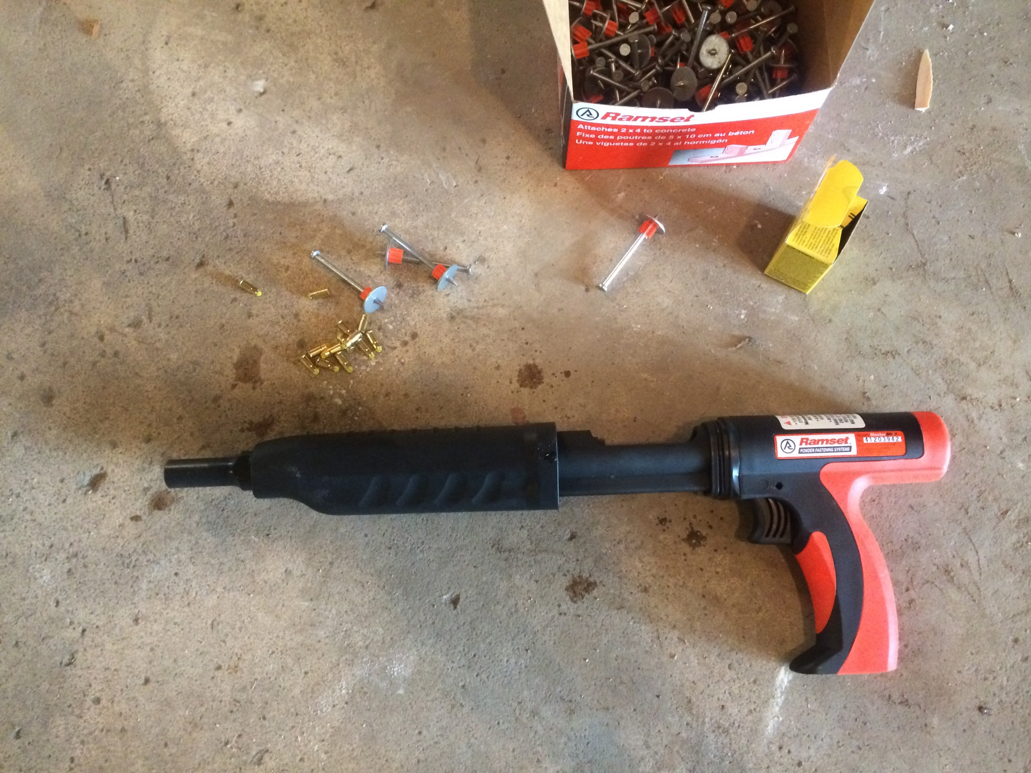
To secure material to concrete slab, a powder actuated nail gun is used.

Slide 12
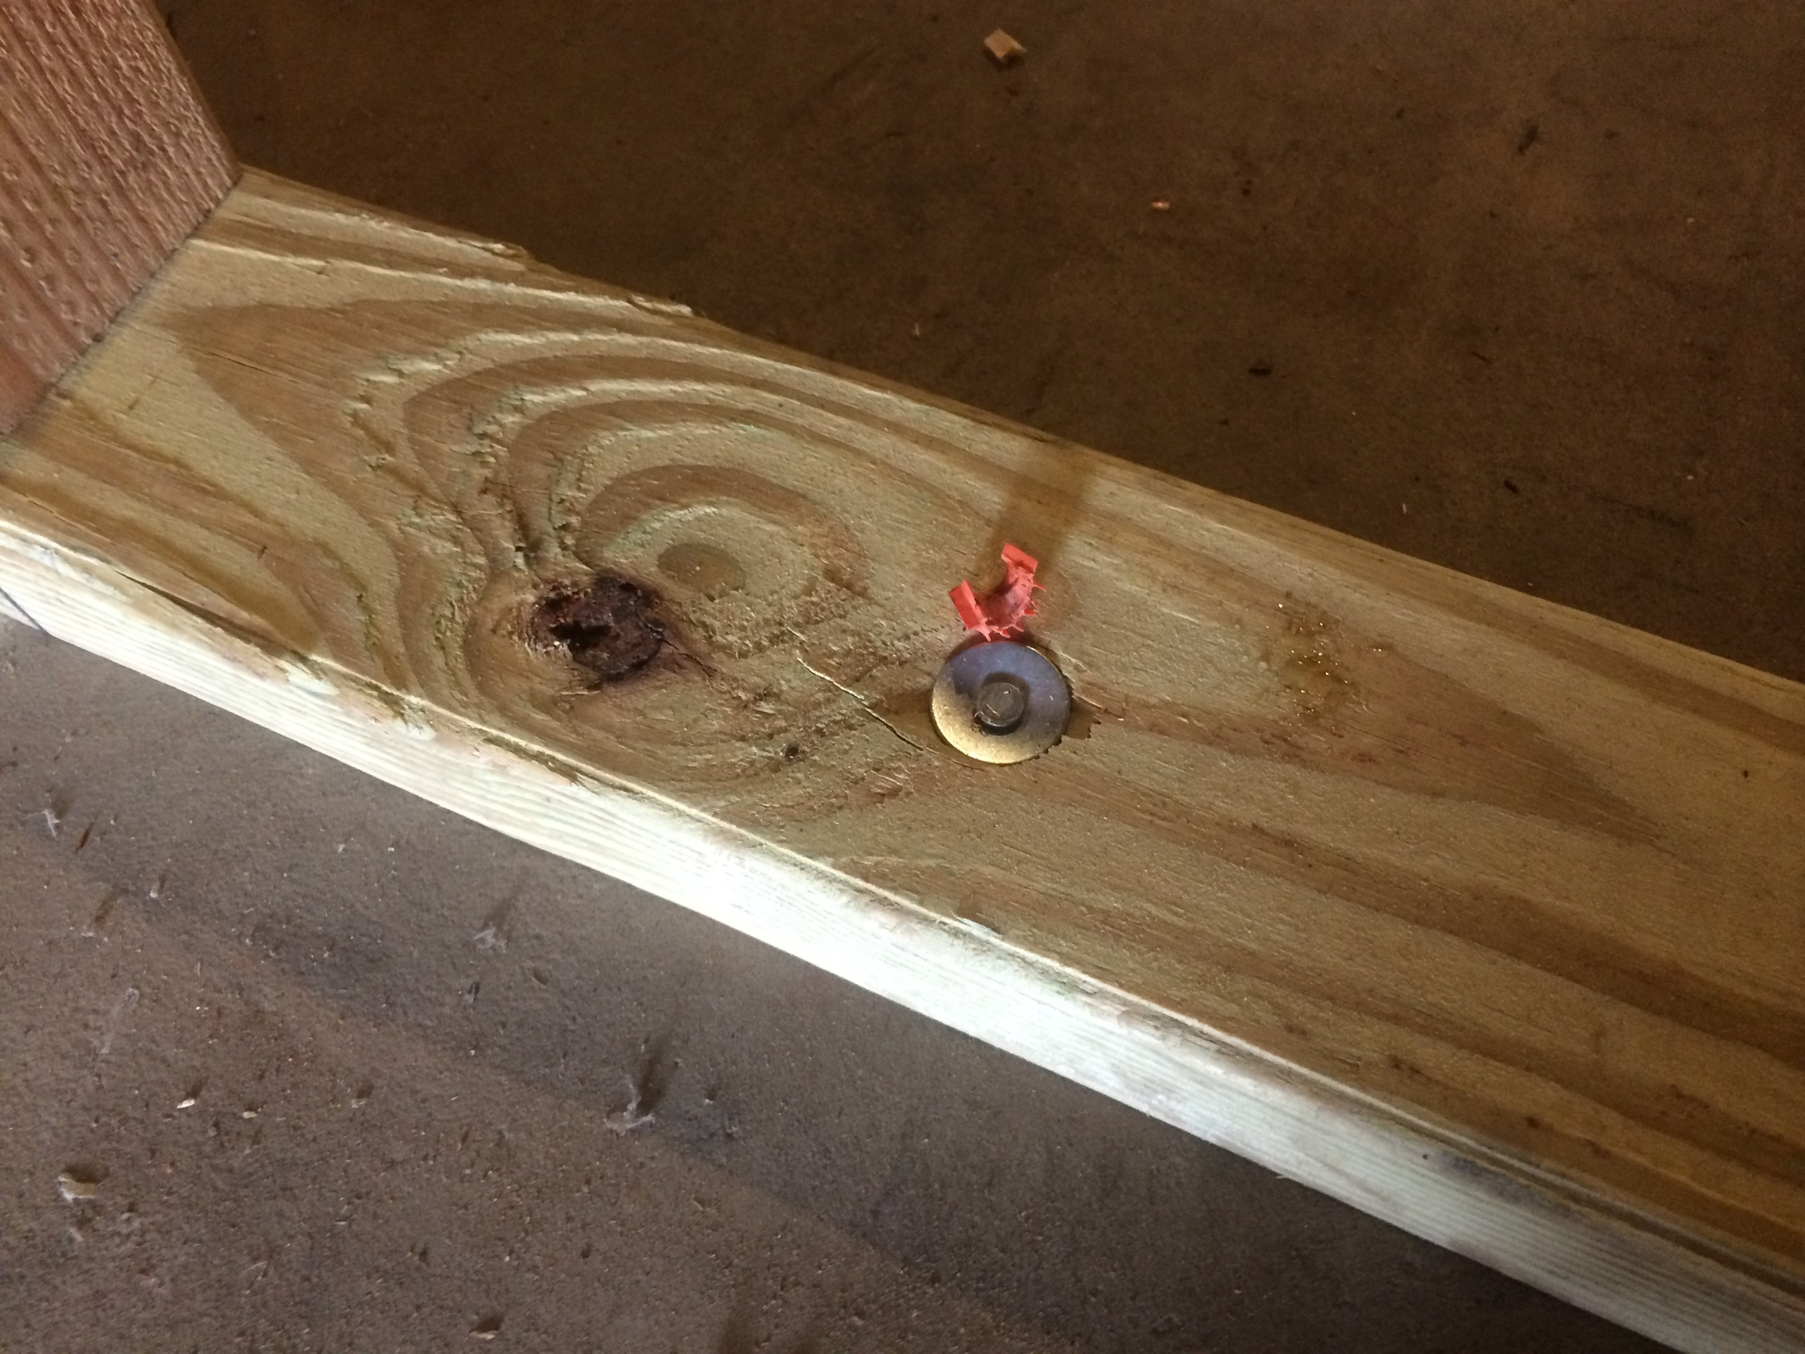
Wall secured to concrete slab with concrete nails

Slide 13
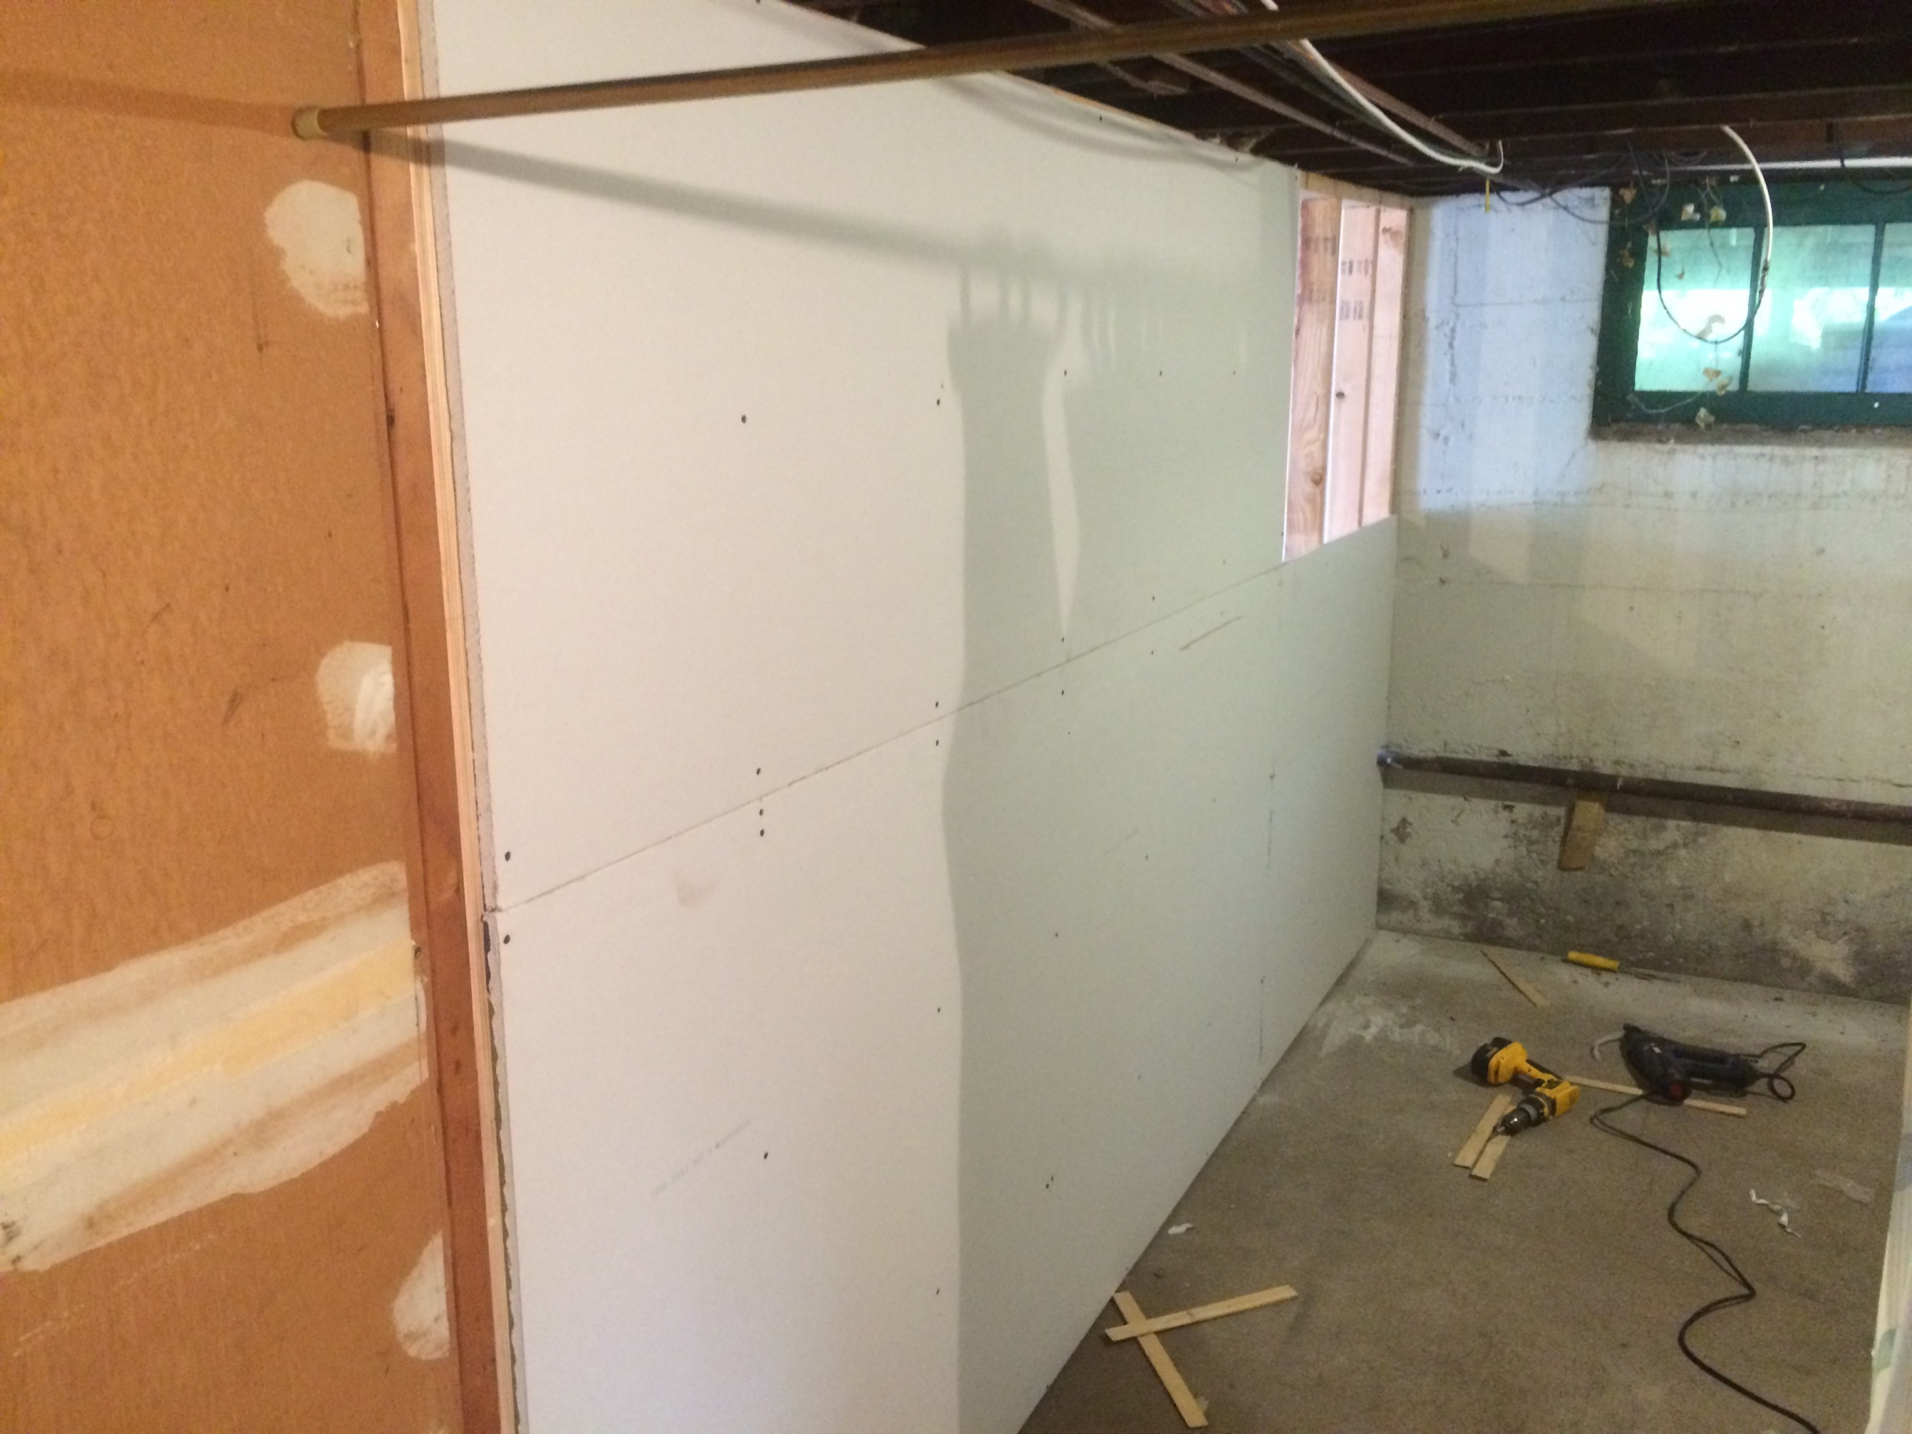
Add sheetrock and secure with screws

Slide 14
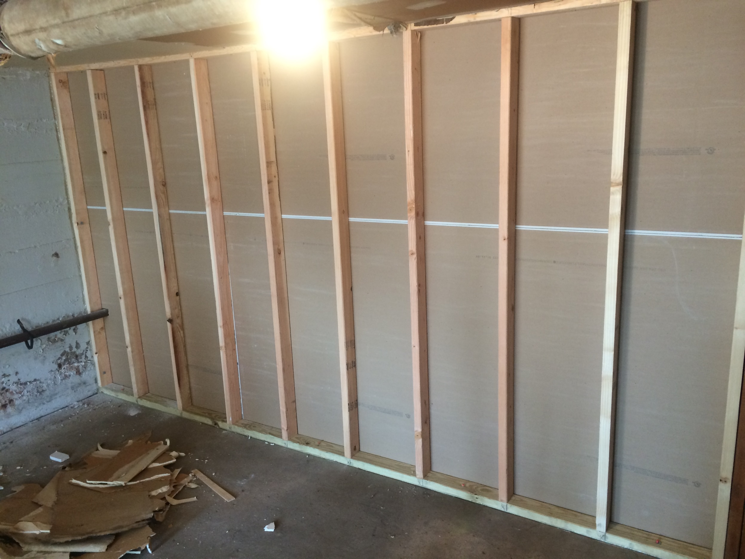
One side complete with sheetrock
(viewed from unfinished side)

Slide 15
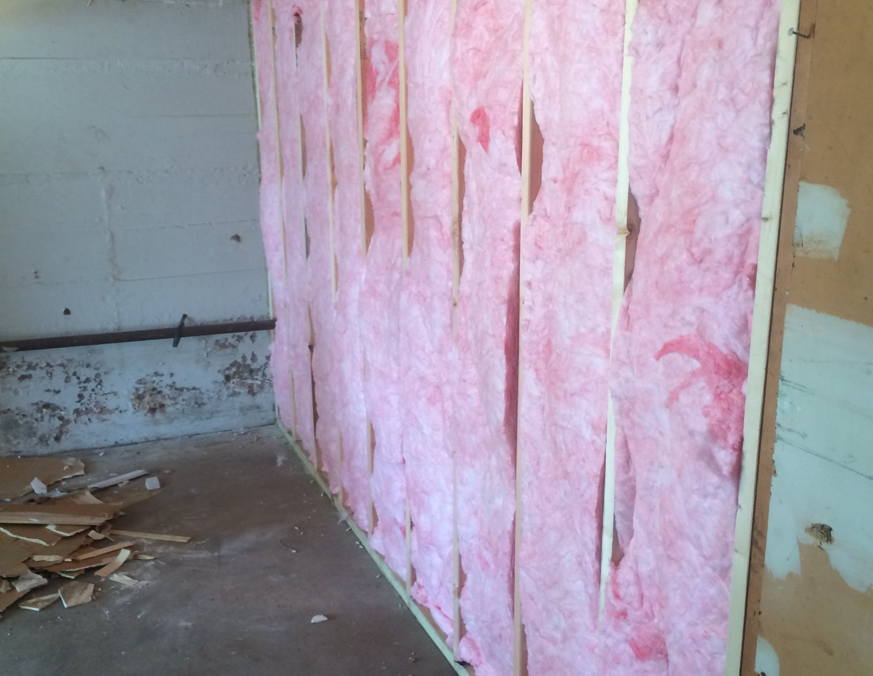
Insulate

Slide 16
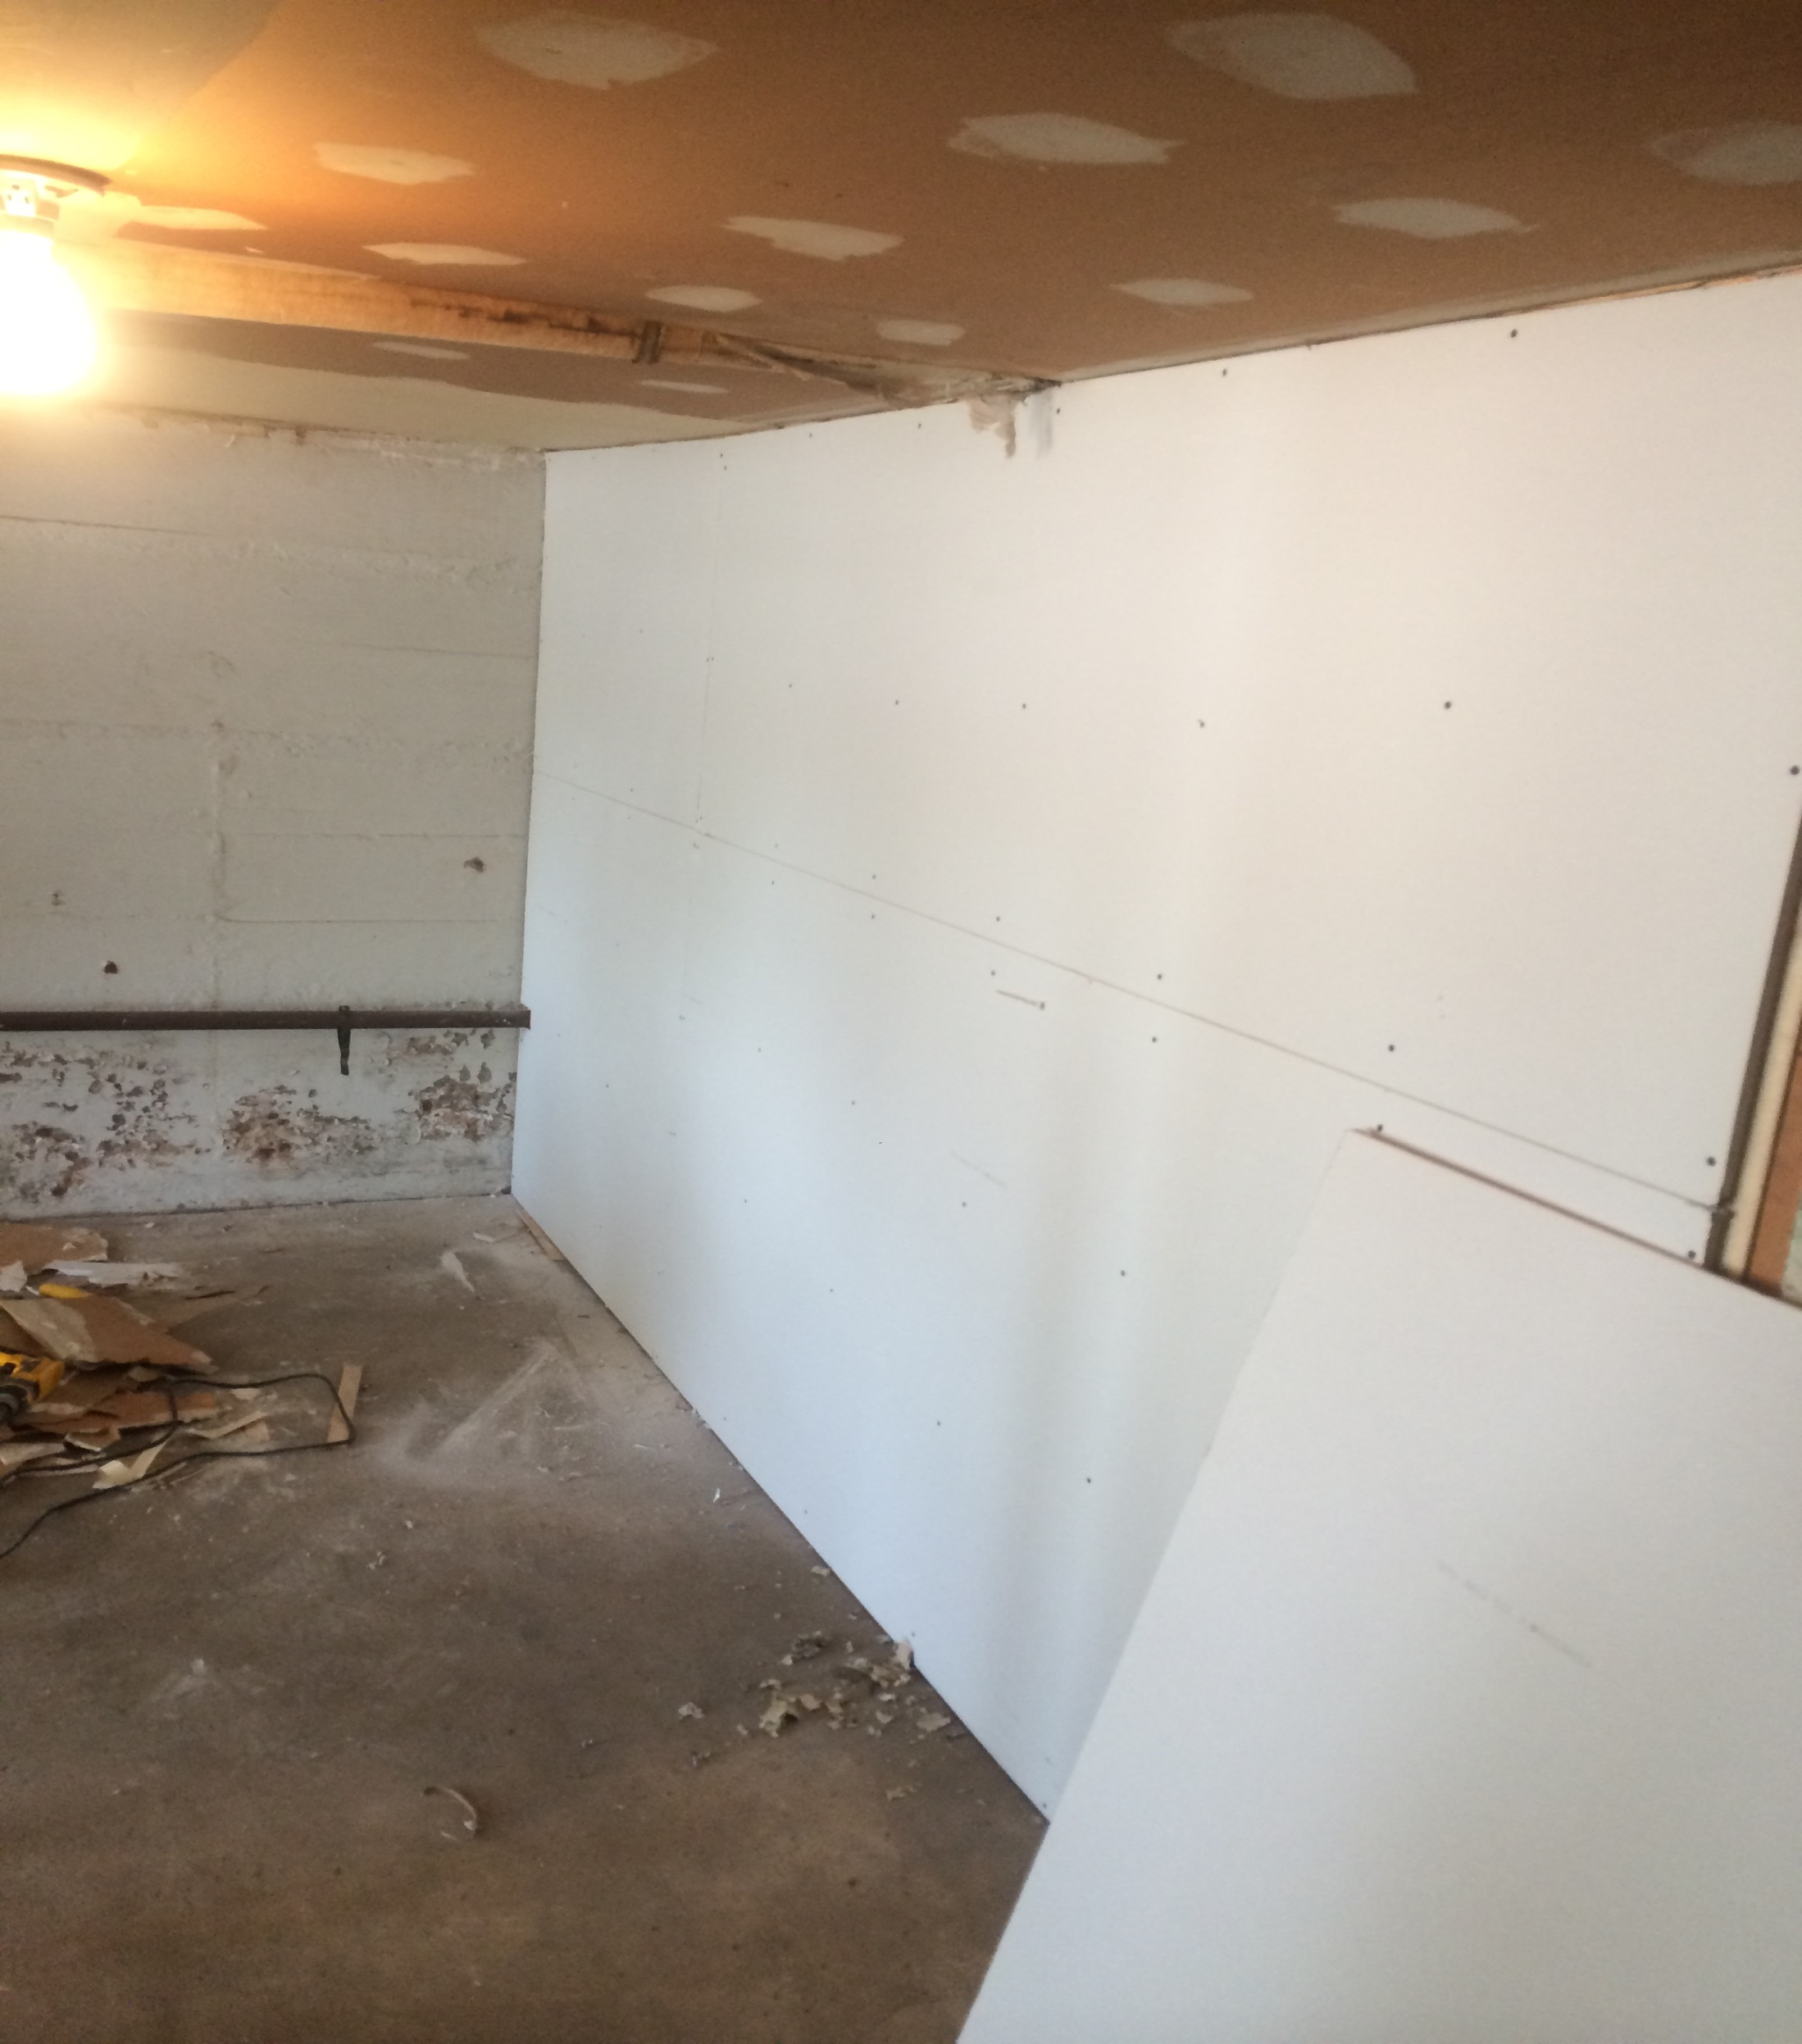
Completed sheetrock

Slide 17
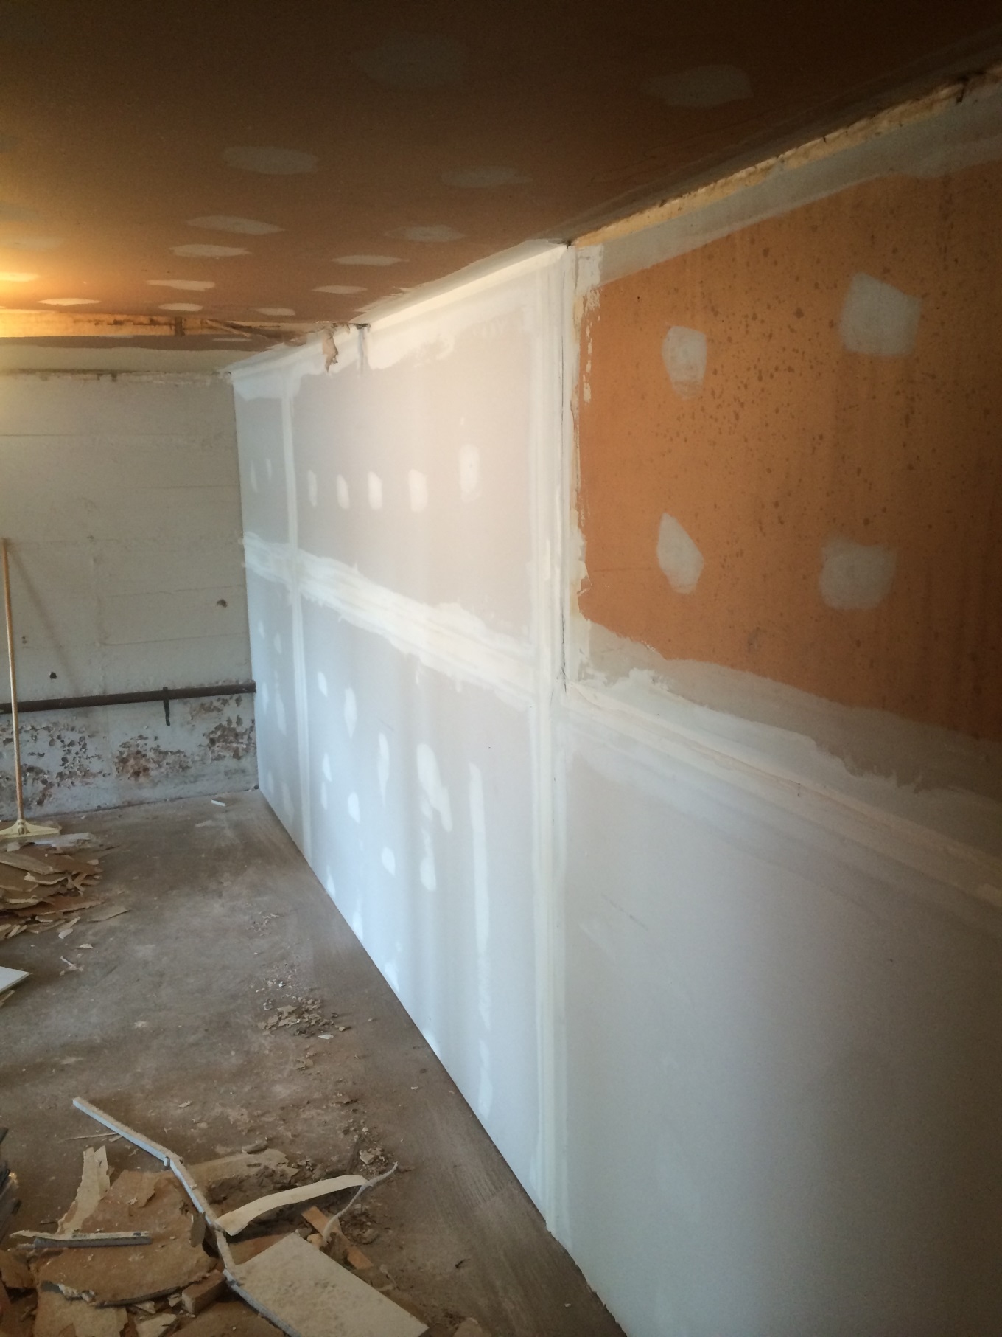
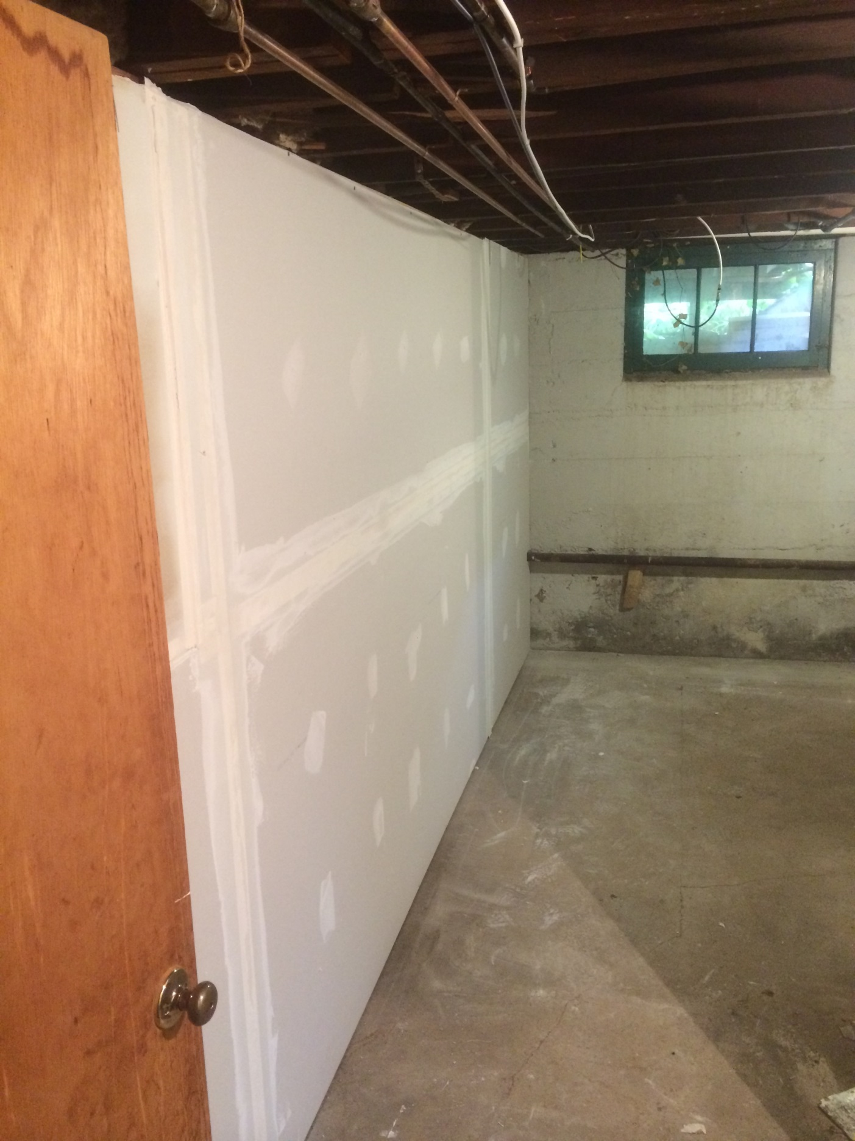
Tape and spackle joints and screw holes.

